Slide 1
Formal methods in SOFTWARE ENGINEERING
Notes:
Instructions to perform a specific task

Slide 2
Today’s Agenda
Introduction to the Course
Objectives of the course
Basic Concepts

Slide 3
Course Introduction
Course Title: Formal Methods
Total Credits: 3 Credits
3 Credits Theory
Pre-requisite: Discrete Structures

Slide 4
Course Learning Outcomes
CLO 1:Describe the costs and benefits of formal methods.
CLO 2: Construct formal models of sequential software systems
CLO 3:Implement sequential software systems based on formal models.

Slide 5
Recommended BOOKS
1-Concise Guide to Formal Methods, Theory, Fundamentals and Industry Applications, 2017, Springer
2-Using Z Specification, Refinement, and Proof by Jim Woodcock and Jim Davies, 2000

Slide 6
Grading scheme
Quizzes:10%
Assignments: 10%
Mid Term:30%
Final:40%
Project/Presentation:10%

Slide 7
Formal Methods
Formal method is a way to takes the specification (written in natural language) and converts it into its mathematical equivalent.
It is normally used in the SDLC Analysis and Design stages.
Formal method will also bring to light all different probable perspective to any given variables and functions that could have been hidden behind the English language.
Notes:
Example requirement::
System shall be able to allow customer to withdraw money between 1000 to 50000 per day.

Slide 8
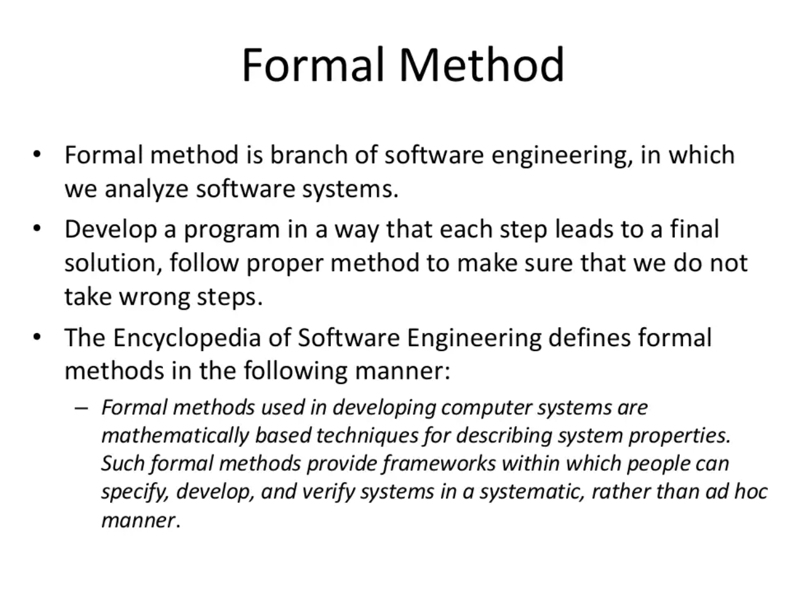

Slide 9
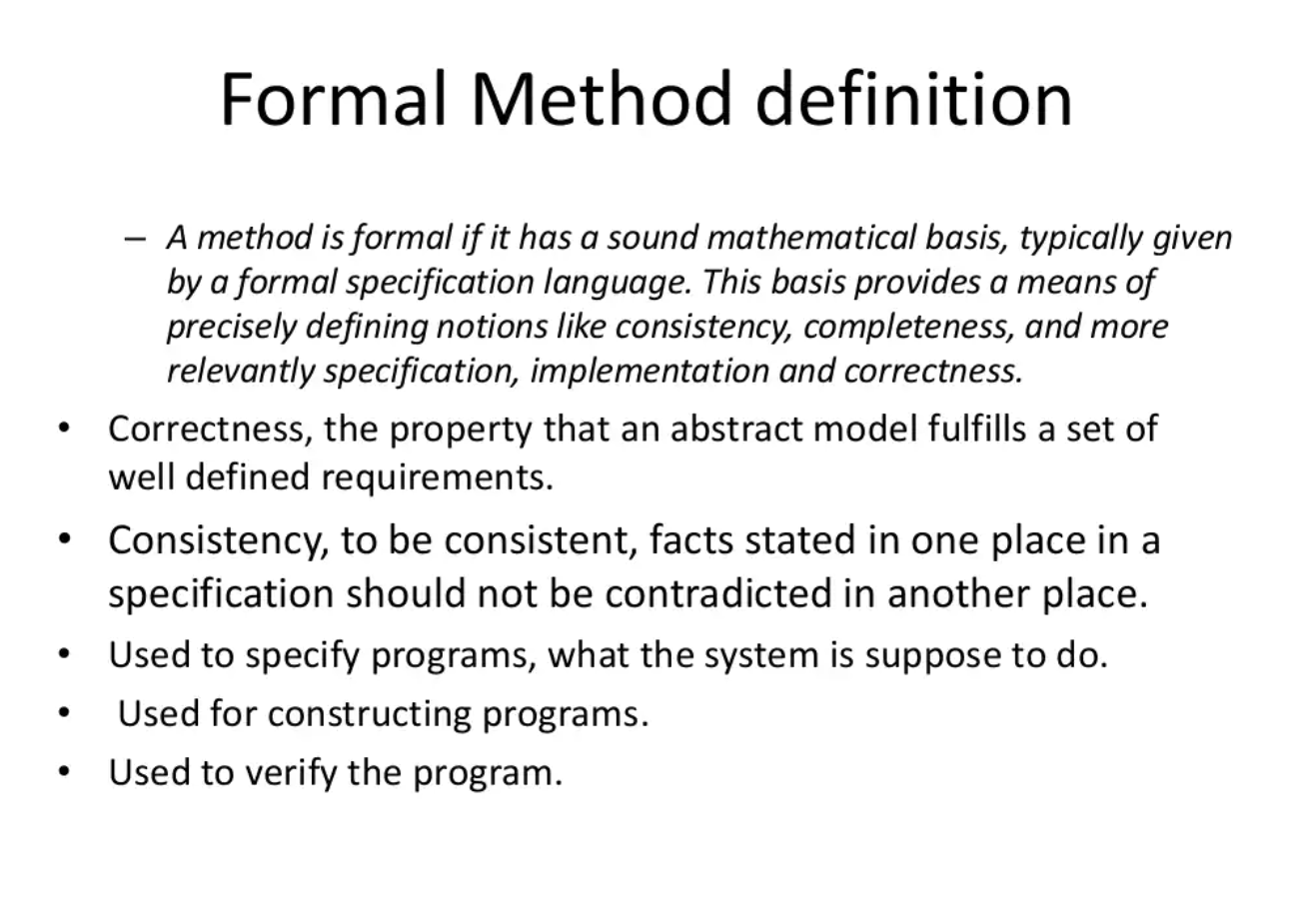

Slide 10
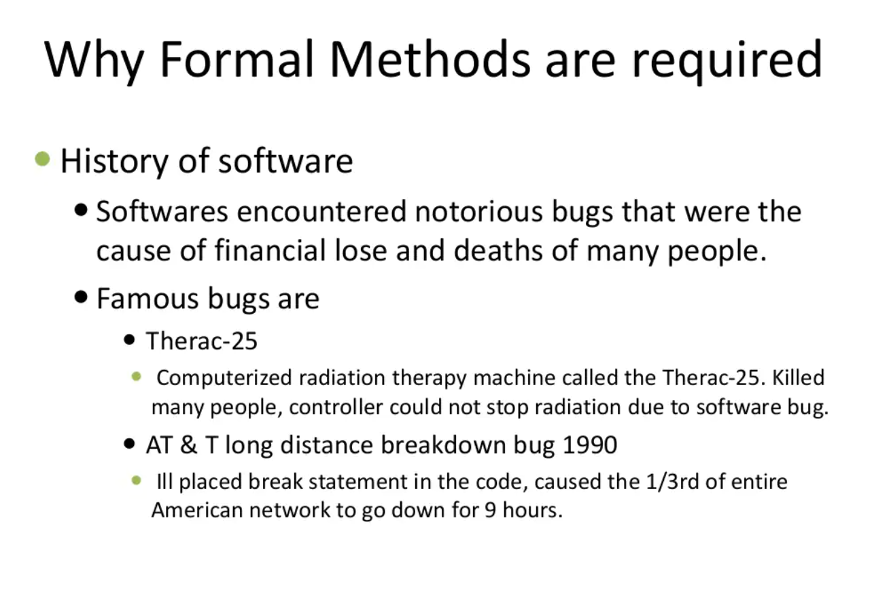
Notes:
NIST National Institute of Standards and Technology reports
Software bugs cost 60 million dollars annualy

Slide 11
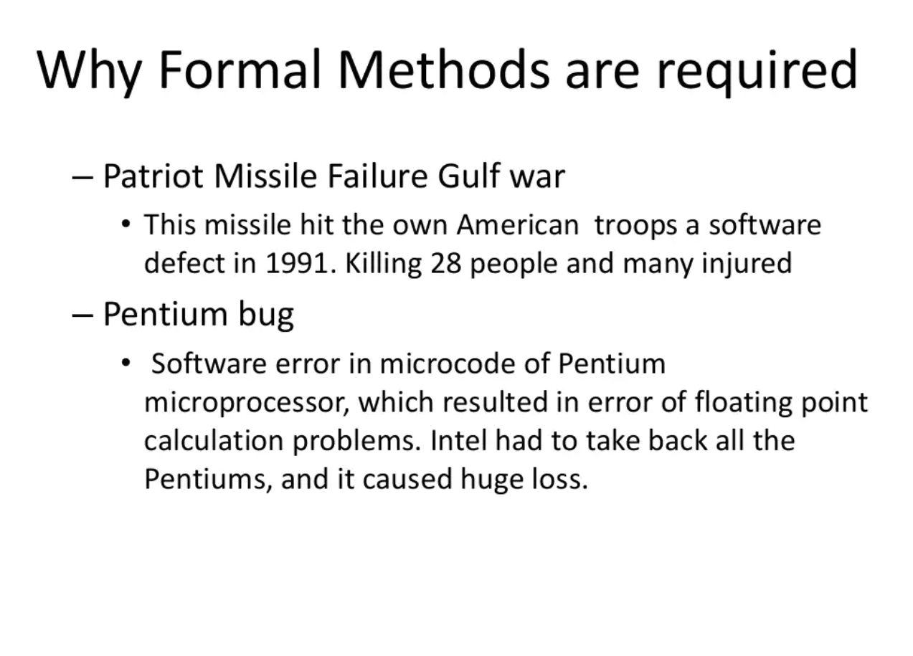

Slide 12
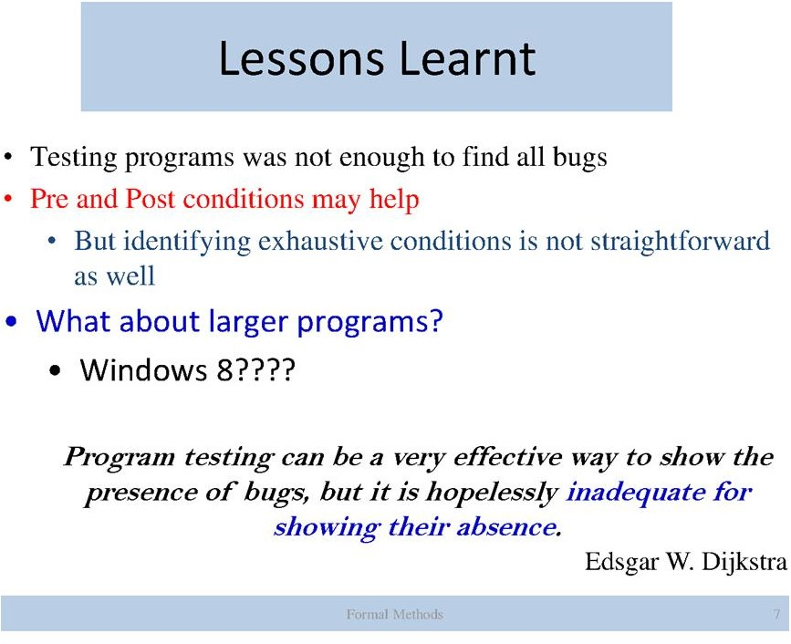
Notes:
Testing is where you make sure your code - as written - actually works the way it's supposed to work.
Formal verification is where you prove mathematically that the underlying algorithm is correct.

Slide 13
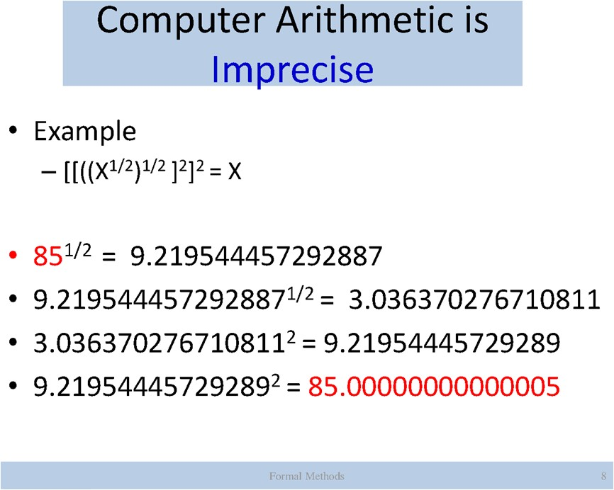

Slide 14


Slide 15
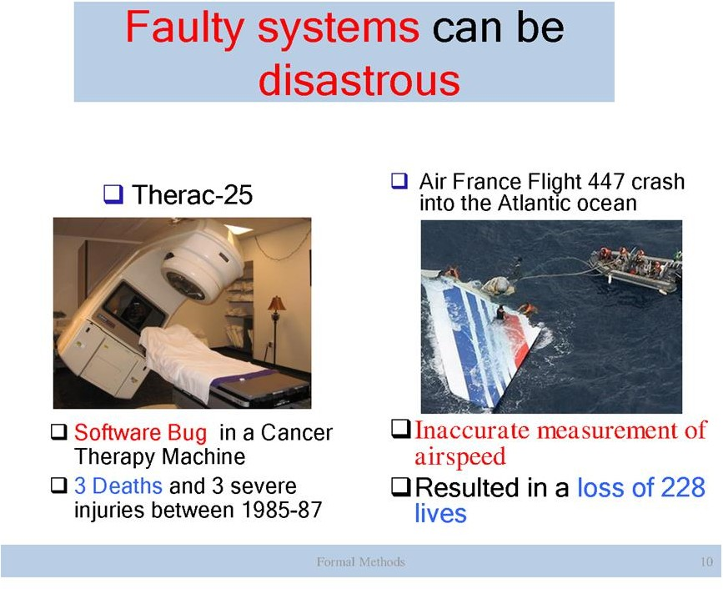

Slide 16
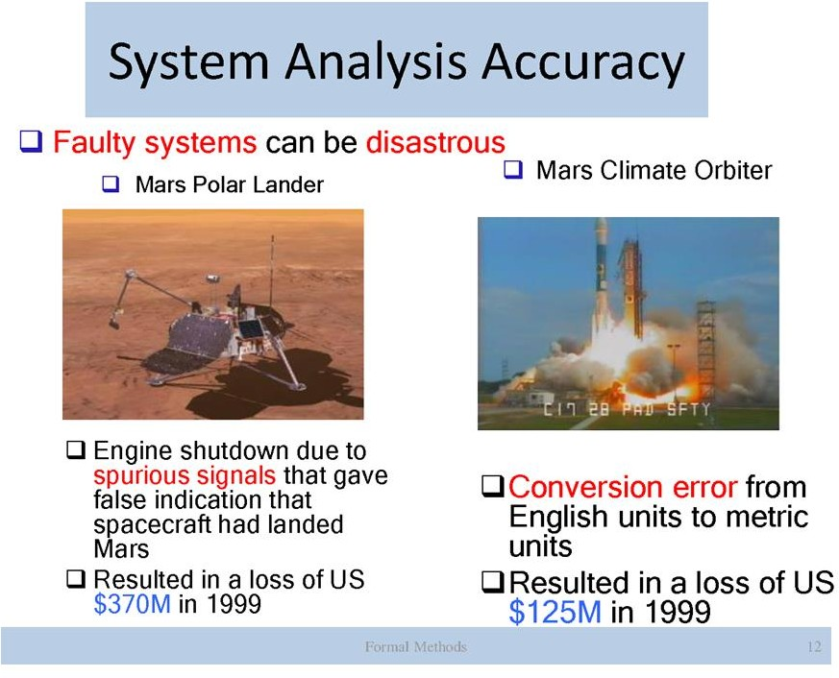

Slide 17
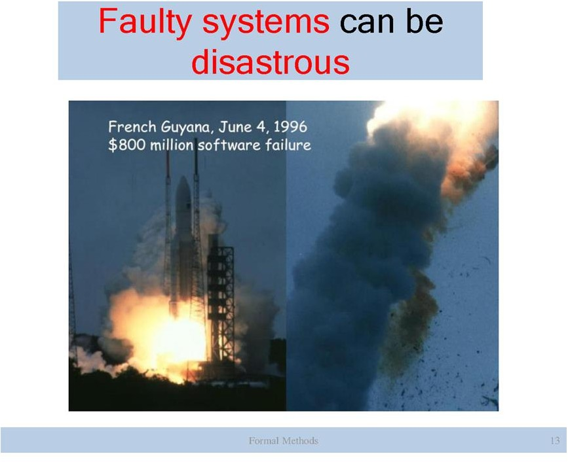

Slide 18
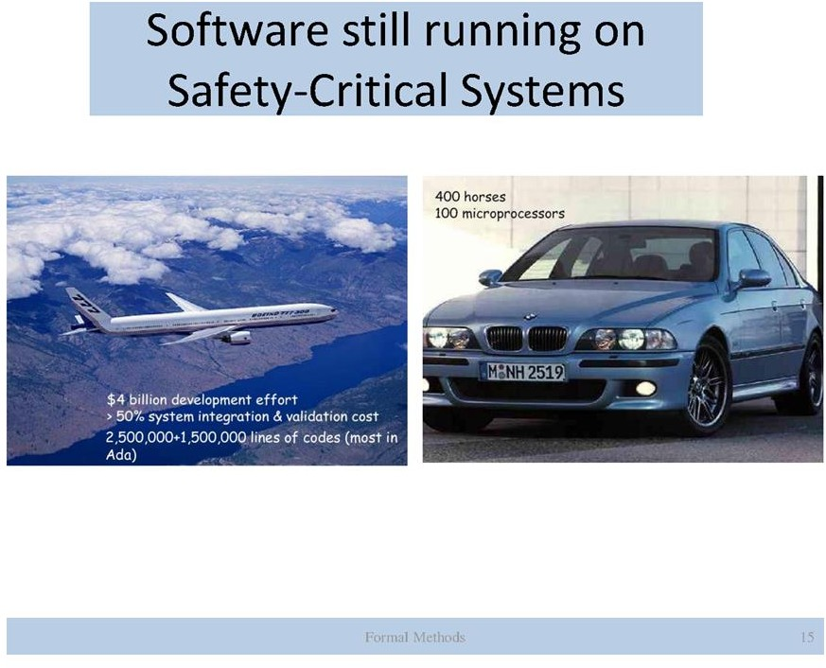

Slide 19
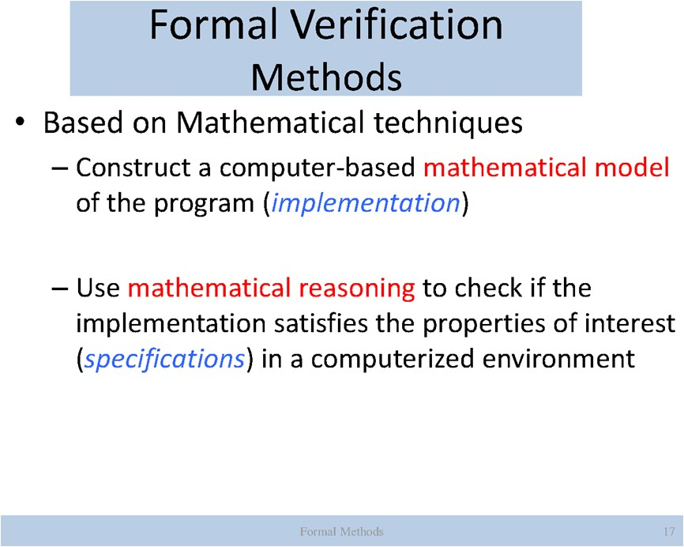

Slide 20
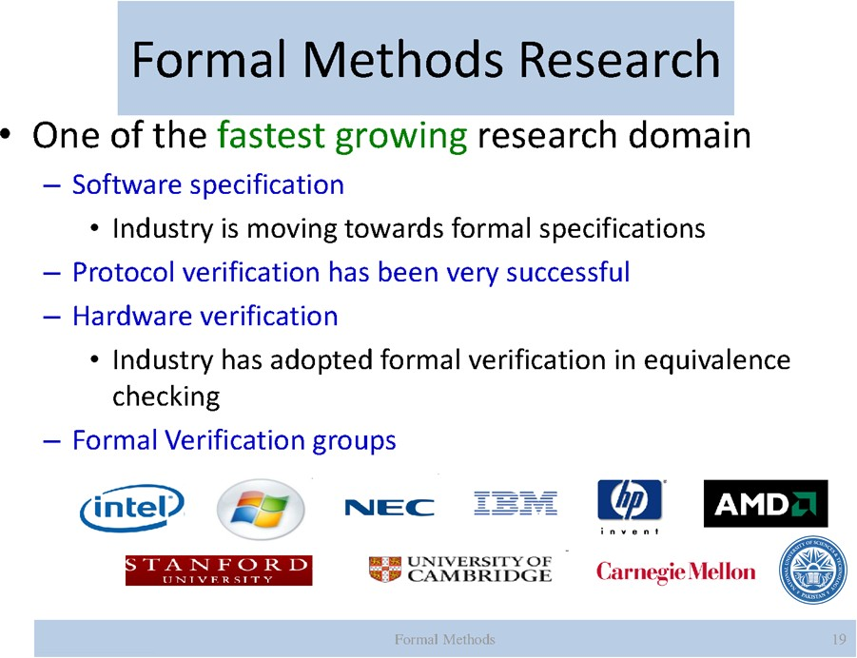

Slide 21
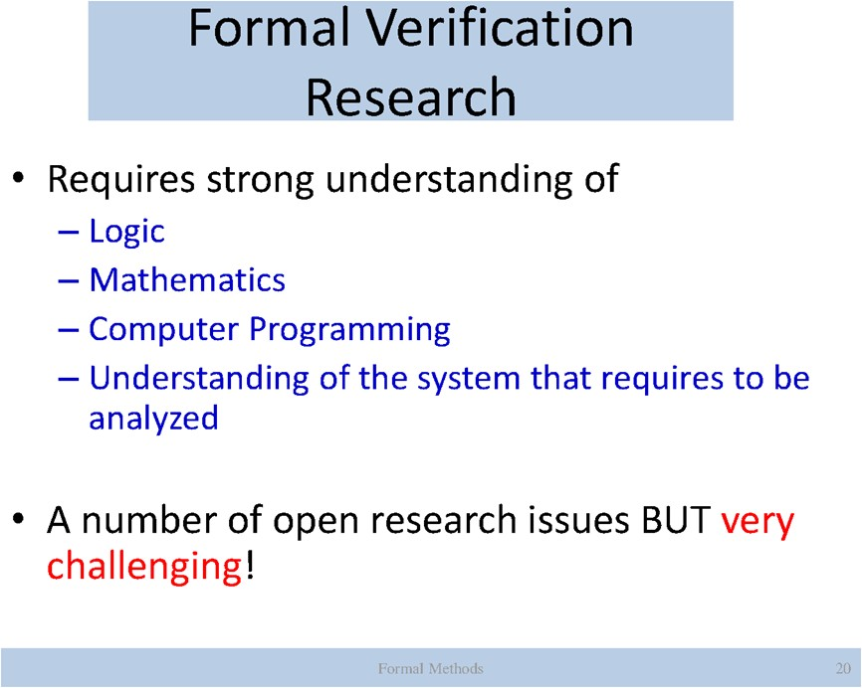

Slide 22
